Slide 1


CHAPTER 4
STUDY OF VARIOUS BACTERIAL GROUPS

Slide 2

Known as the nitrifying bacteria or called a common fertile bacteria.
Are strictly autotrophic.Chemolitrophically at the expense of reduced inorganic nitrogen compounds (oxidation of ammonia to nitrates).
Nitrobacter
Nitrospina
Nitrococcus
Nitrosipra
Nitrosomonas

Slide 3
○ There are currently four genera accepted in the family. The genus Nitrobacter is the type genus. The other genera are Nitrospina, Nitrococcus and Nitrosipra. The GC content of the DNA is 50-62 mol%.
Ammonia-oxidizing bacteria-the nitrosifyers (Nitrosification)
Nitrate-oxidizing bacteria-the nitrifying (Nitrification)
Higher plants cannot utilize nitrites a s their source of nitrogen.Nitrate is the most useful form of nitrogen in agricultural purposes.
Nitrobacter oxidizes nitrite to nitrates.

Slide 4
Nitrosifying bacteria
○ NH₃ + O₂ + 2H⁺ + 2e⁻ → NH₂OH + H₂O (1.1)
○ NH₂OH + H₂O → NO−2 + 5H⁺ + 4e⁻ (1.2)
○ NH₃ + O₂ → NO−2 + 3H⁺ + 2e⁻
Nitrifying bacteria
○ NO2⁻ + H₂O → NO−3 + 2H⁺ + 2e⁻ (2)

Slide 5
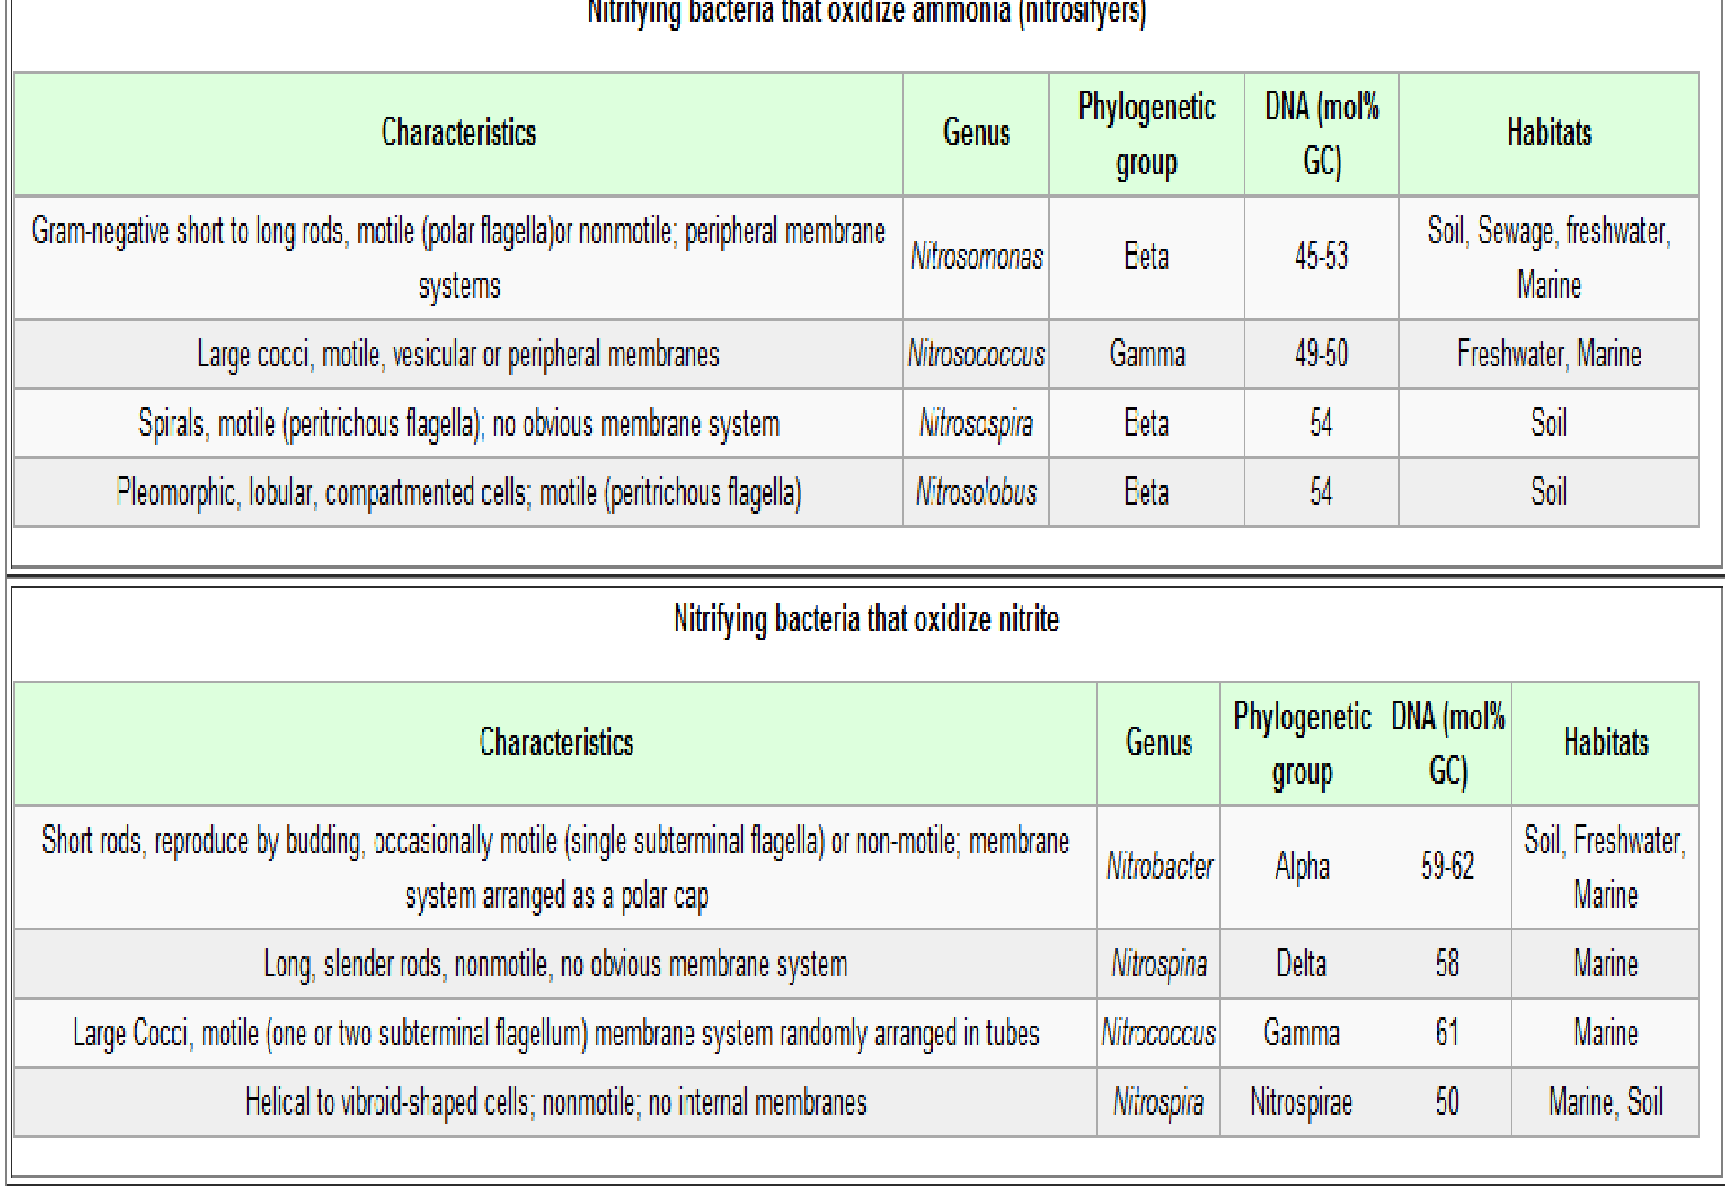

Slide 6

These are Gram-negative bacteria.
Non-sporing non-acid fast rods, which may be pleomorphic or coccoid (Nitrobacter), some are slender rods (Nitrospina), cocci (Nitrococcus) or spiral to comma-shaped (Nitrosipra)
They may be motile.
They are characterised by their ability to use nitrite as the o n l y energy.
They are facultative or obligate lithoautotrophs.
They fix CO2 autotrophically through the Calvin cycle but are not photosynthetic.
They grow best in the dark around 28°C at pH between 7. 6 - 7. 8 and many grow mixotrophically than lithoautotrophically.
They have all the enzymes of the tricarboxylic acid cycle.

Slide 7

There are currently three species recognized within this genus,
N. winogradskyi, N. hamburgensis and N. vulgaris.
Differ slightly in morphology. They are pleomorphic rods, which may form coccoid cells. They may be motile by a subpolar to lateral flagellum.
Often the cells have a polar cap of flattened membrane vescicles. There are regularly arranged particles covering the inner side of the cytoplasmic and intracytoplasmic nitrite-oxidising membrane.
The species are subdivided according to the GC content of the DNA, DNA/DNA homology, serological characteristics and the patterns found of the membrane-bound heme proteins. The GC content of the DNA is 59-62 mol%.

Slide 8

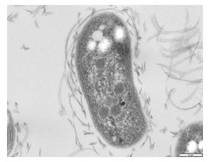

Slide 9

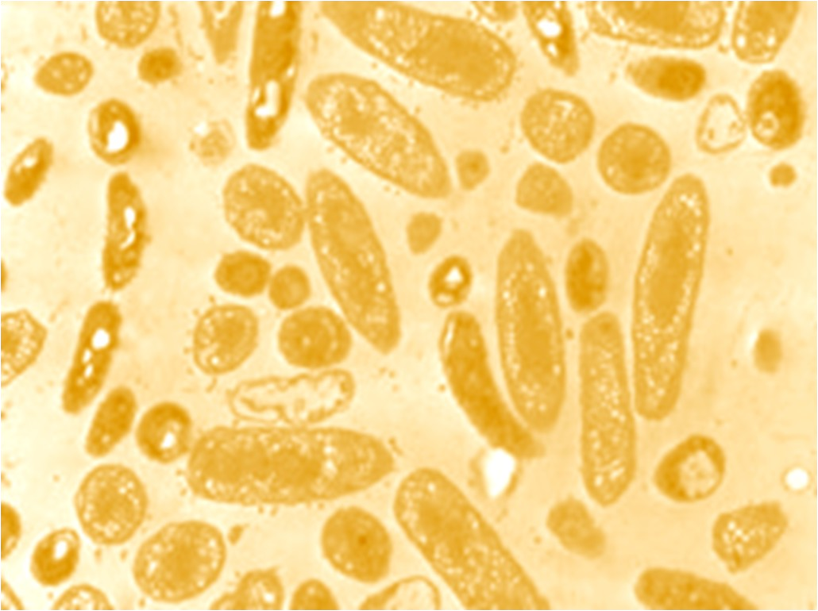
○ Nitrospina:
They are slender non-motile rods.No obvious membrane system. There is only one species N. gracilis. They are obligate lithoautotrophs. They have glycogen-like storage inclusion bodies. The GC content of the DNA is 58 mol%.

Slide 10
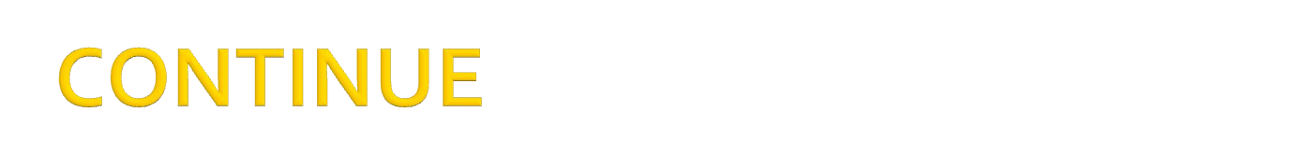
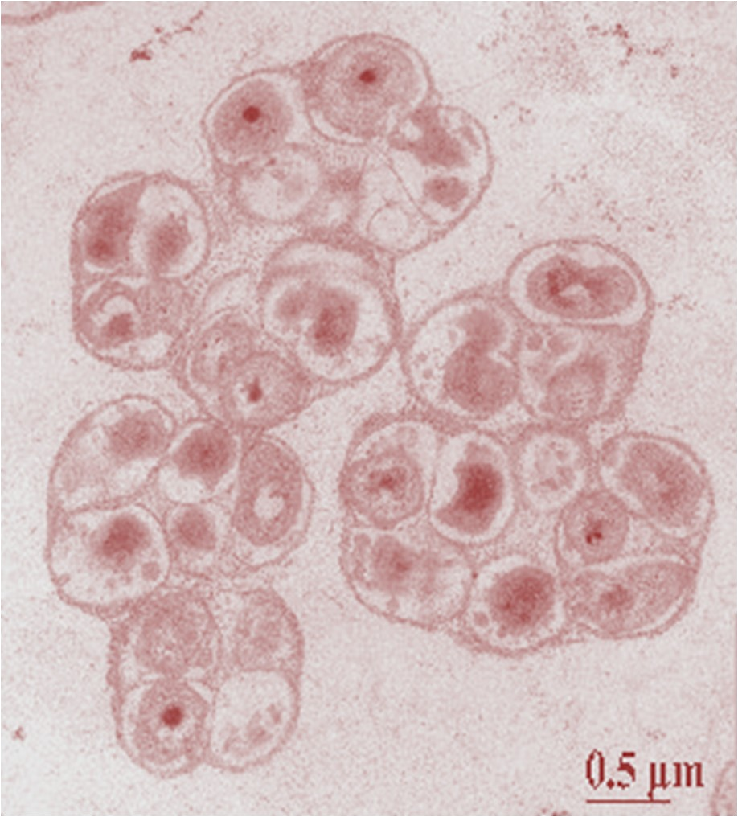
○ Nitrosipra:
They are vibrio-like to spiral organisms.,motile (peritirchous flagella).There is only one species N. marina.Can live in marine or nonmarine habitats
They grow preferentially mixotrophically rather than lithoautotrophically. Particles are arranged in rows on the membranes. There are glycogen-like storage deposits. The GC content of the DNA is 50 mol%.

Slide 11

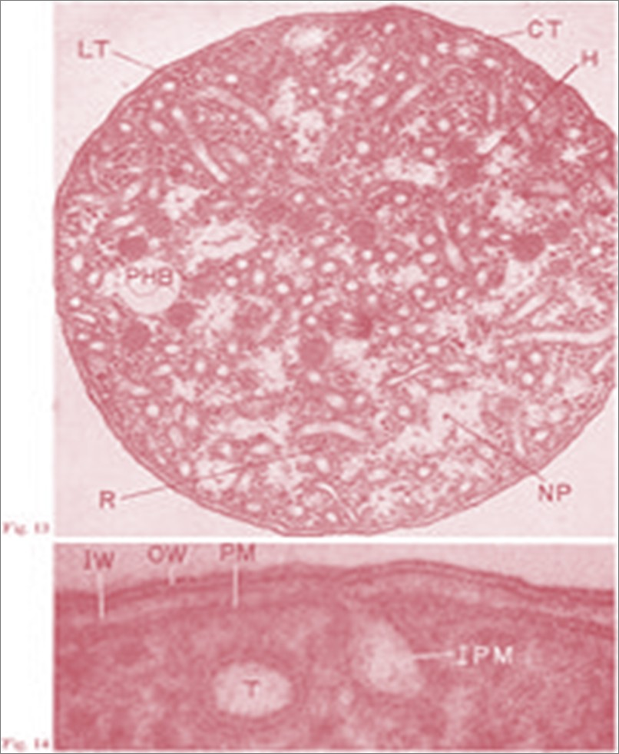
○ Nitrococcus:
The spherical motile cells have one to two flagellae. The marine species N. mobilis is the only species. The inner surface of the tubular membrane system is covered with particles. They are obligate lithoautotrophs. There are present carboxysomes,
poly-b-hydroxybutyrate (PHB) and glycogen-like storage materials. The GC content of the DNA is 61 mol%.

Slide 12

○ Nitrifying bacteria are widespread in soil and water.Highest numbers in habitats where considerable amount of ammonia are present.
Use mineral salt media contain ammonia or nitrite as electron donor and bicarbonate as sole carbon source.
Monitoring growth: Assay for production of nitrite.

Slide 13
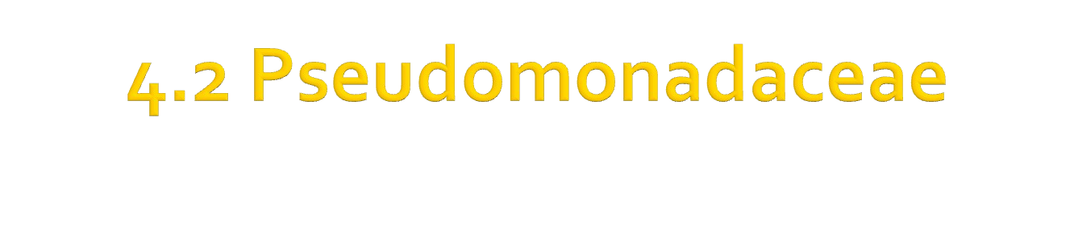

Slide 14

Members of genus Pseudomonas
Enzymatically active, metabolizing a wide variety of proteins, fats,carbohydrate and other organic compounds.
Thus, they are excellent and ubiquitous scavengers
Primarily saprophytic and ubiquitous
Found in soil, water, on plant-life and man’s environments,sewage.
Primarily causing infection and disease

Slide 15

Pseudomonas aeruginosa (formerly Pseudomonas pyocanea)
Pseudomonas pseudomallei (Whitmore’s bacillus)

Slide 16
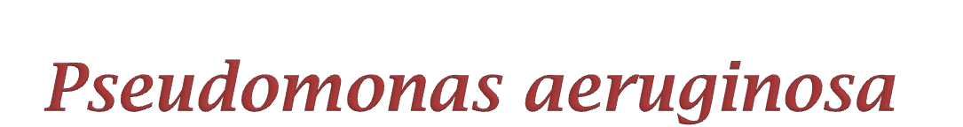

Slide 17

A Gram-negative bacteria,non-sporing bacillus,motile with polar flagella.
In hospital environment
Especially moist places such as sinks, bowls, drains, cleaning buckets and humidifiers.
Can grow in eye drops, oitments and weak antiseptic solutions

Slide 18

○ Skin infection – burn site, wound pressure sores and ulcers, as secondary invaders
Urinary tract infection – associate wt chronic urinary infection
Respiratory infection – especially pt wt cystic fibrosis/ immunosuppression
External ear infection (otitis externa)
Eye infection (usually hospital –acquired)
Septicaemia (pt wt poor health) – proliferation of bacteria in
blood → fever & organ damage.

Slide 19


Slide 20

○ Naturally found in rice paddy fields, the mud in river banks and surface stagnant water. The organism can infect cattle, pigs and other animal.

Slide 21

Cause melioidosis in human and animal
Area of countries that have rice-growing area, the bacteria will enter open wounds but can also be inhaled
In melioidosis, pus filled nodules and abscess form in lungs, spleen, joint or skin
Severe diarrhoea and vomiting may occur and occasionally
septicemia
Present of fever and rash

Slide 22


Slide 23

Gram negative
Motile – virtue of polar flagella
Rods
Non-sporing
Non-capsulated
Clearly identify using Giemsa stain in Gram staining

Slide 24

Strict aerobe
Grow in NA colonies are 2-4 mm in diameter, convex
Smell sweet musky odour and the yellow –green pyocyanin pigment coloration which diffuses into the medium
Produce flourescent green in ultra violet (UV) light
Some strain produce pigment such as red
Certain strain are heavily mucoid

Slide 25
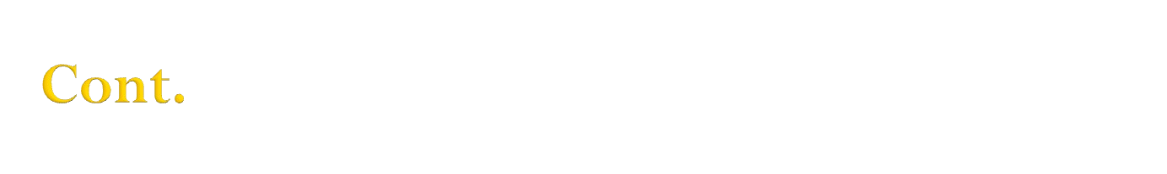
○ In BA – large, flat and BETA-hemolytic colonies
In Kligler iron agar produce pink-red slope and butt
Grow well in NA, MacConkey agar and other media containing bile salts.(non lactose fermenters).
It can denitrify and produces gelatinase. It grows on
acetamide and geraniol and gives a weak or delayed tween 80 hydrolysis.
Large amounts of extracellular polysaccharides are produced by some strains. Their optimal growth is at 37°C
and they can grow at 42°C.

Slide 26

Non-hemolytic, small, ringed and striated in BA.
In MacConkey agar, the colonies have a rough and corrugated appearance.
Does not produce pyacyanin or flourescein but form a brown pigment
Give off an ammoniacal smell
(most Pseudomonas grow well at 41-42ºC)

Slide 27

Exotoxin A is produced under conditions of iron limitation by most strains. The toxin attacks one of the elongation factors in translation during protein synthesis which is thus inhibited.
Strains produce a haemolysin, causing beta-haemolysis.
The production of large amounts of extracellular polysaccharides is associated with strains isolated from cases of cystic fibrosis.
Endotoxin and exotoxin S are other virulence factors as are proteases and elastase.

Slide 28

All pseudomonas are oxidase positive (except P. maltophilia), catalase positive, indole negative and mostly citrate positive.
Produce acid from carbohydrate by oxidase, not fermentation.
Glucose is oxidized and also maltose by most species except
P.aeruginosa.
Utilised glucose and without gas production.

Slide 29

○ Serogrouping is based on 12 somatic (O) antigen groups.
Flagellar antigens are difficult to prepare and therefore not generally used for serogrouping.

Slide 30

Mostly resistant to antibiotic
P. pseudomallei able to be killed by chloramphenicol and tetracycline
Others by some penicilins and cephalosporins, etc

Slide 31


